Slide 1
DBSCAN algorithm
Marko Živković
3179/2015

Slide 2
Density-based spatial clustering of applications with noise (DBSCAN)
Clustering is the process of grouping large data sets according to their similarity
Density-based clustering:
groups together points that are closely packed together
marks as outliers points that lie alone in low-density regions
DBSCAN obtains the density associated with a point by counting the number of points in a region of specified radius around the point
Input parameters:
Radius value epsilon ε
Minimum points required to form cluster (minPts)

Slide 3
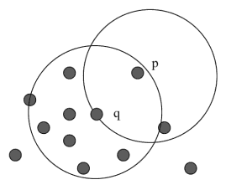
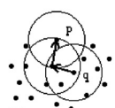
Points Classification
Core point - At least minPts points are within distance ε of it
Directly density-reachable
Point p is directly density-reachable from point q
if p is within the Eps-neighborhood of q,
and q is a core point.
Density-reachable
Point p is density-reachable from point q
if there is a chain of points p1,. . .,pn,
such that p1 = q and pn = p
and pi+1 is directly density-reachable from pi

Slide 4
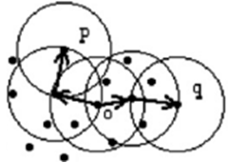
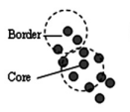
Points Classification
Density-connected
Point p is density-connected to point q
if there is point o such that both p and q are density-reachable from o
Border Point
Point p is a Border point if it is not a Core point
but density-reachable from another Core Point
Noise
Points not reachable from any other point

Slide 5
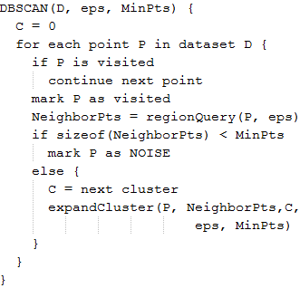
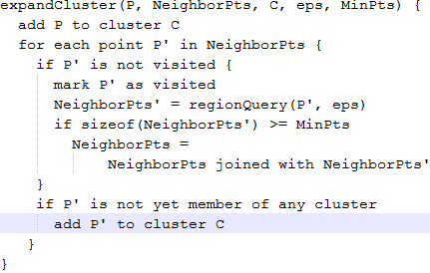
Algorithm

Slide 6
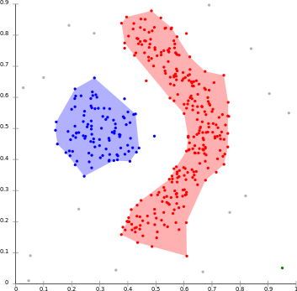
Advantages
Does not require the number of clusters in the data a priori
Can find arbitrarily shaped clusters
Robust to Noise
Mostly insensitive to the ordering of points in the database

Slide 7
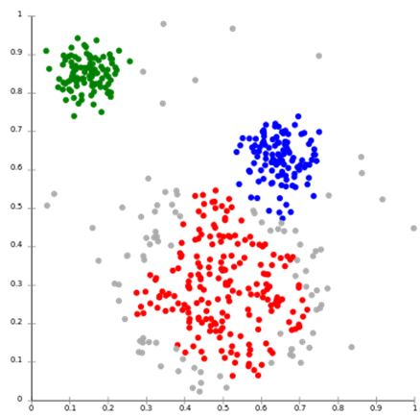
Disadvantages
Border points reachable from more than one cluster, can be part of either cluster (DBSCAN* - treats border points as noise)
Choosing a meaningful distance threshold ε can be difficult
Cannot cluster well data sets with large differences in densities
(minPts-ε combination cannot be chosen appropriately for all clusters)

Slide 8
Applications
Satellites images
Classifying areas of the satellite-taken images according to forest, water and mountains.
X-ray crystallography
Locates all atoms within a crystal, which results in a large amount of data.
DBSCAN algorithm can be used to find and classify the atoms in the data.
Anomaly Detection in Temperature Data
Relevant due to the environmental changes (global warming)
It can also discover equipment errors and so These unusual patterns need to be detected and examined

Slide 9
regionQuery on CPU

Slide 10
regionQuery on GPU

Slide 11
Results
./dbscan numPts xmin xmax ymin ymax minPts eps
./dbscan 100 -10 20 -30 15 5 50
CPU implementation time: 0.179264[ms]
GPU implementation time: 1.608224[ms]
./dbscan 1000 -10 20 -30 15 5 10
CPU implementation time: 29.422592[ms]
GPU implementation time: 21.141760[ms]
./dbscan 10000 -10 20 -30 15 5 3
CPU implementation time: 1329.740479[ms]
GPU implementation time: 331.086670[ms]
./dbscan 100000 -10 20 -30 15 5 1.2
CPU implementation time: 132792.062500[ms]
GPU implementation time: 19935.035156[ms]

Slide 12
References
DBSCAN, Backlund H., Hedblom A., Neijman N., Linköpings Universitet, 2011
ST-DBSCAN, Birant D., Kut A., Dokuz Eylul University, 2006
https://en.wikipedia.org/wiki/DBSCAN
https://en.wikipedia.org/wiki/Cluster_analysis#Density-based_clustering
http://codereview.stackexchange.com/questions/23966/density-based-clustering-of-image-keypoints
http://mups.etf.rs/vezbe/MPS%20-%20CUDA.pdf
http://mups.etf.rs/lab/MPS%20-%20Lab4%20-%20CUDA.pdf

